Slide 1
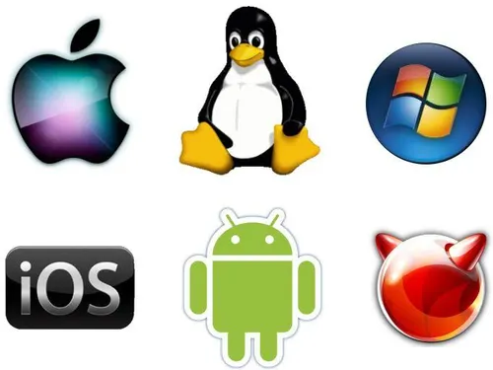
Introduction to Operating System
Chapter 1
Overview, History, Types, and Installation via VirtualBox
Notes:
"In this chapter, we’ll explore what an Operating System is, its history, the different types of OS, and how we can install one using VirtualBox. This will help us understand the foundation of every computing system."

Slide 2
Learning Objectives
Define what an operating system is and explain its role in computing.
Describe the key functions and responsibilities of an OS.
Trace the historical evolution of operating systems from batch systems to modern cloud-based OS.
Identify and differentiate between various types of operating systems.
Demonstrate the basic steps of installing an operating system

Slide 3
What is an Operating System?
The OS is system software that acts as an interface between users and computer hardware.
It manages hardware, software resources, and provides services for application programs.
Notes:
n operating system is the core software that makes your computer usable. Without it, you wouldn't be able to run programs, use files, or interact with hardware. Think of it as a bridge between you and the machine

Slide 4
Key Functions of an OS
• Process Management
• Memory Management
• File System Management
• Device Management
• Security and User Interface
Notes:
The OS handles everything behind the scenes. It manages which program runs and when (Process Management), keeps track of memory usage, handles files, and manages devices like printers or keyboards. It also controls access to the system for security.

Slide 5
History and Evolution of OS
1940s-1950s
Early Beginnings
Programs were manually loaded and run, one at a time.
The first operating system was introduced in 1956. It was a batch processing system GM-NAA I/O (1956) that automated job handling
1960s
Multiprogramming and Timesharing
Introduction of multiprogramming to utilize CPU efficiently.
Timesharing systems, like CTSS (1961) and Multics (1969), allowed multiple users to interact with a single system
1970s
Unix and Personal Computers
Unix (1971) revolutionized OS design with simplicity, portability, and multitasking.
Personal computers emerged, leading to simpler OSs like CP/M (1974) and PC-DOS (1981).
1980s
GUI and Networking
Graphical User Interfaces (GUIs) gained popularity with systems like Apple Macintosh (1984) and Microsoft Windows (1985).
Networking features, like TCP/IP in Unix, became essential.
1990s
Linux and Advanced GUIs
Linux (1991) introduced open-source development.
Windows and Mac OS refined GUIs and gained widespread adoption.
2000s-Present
Mobility and Cloud
Mobile OSs like iOS (2007) and Android (2008) dominate.
Cloud-based and virtualization technologies reshape computing, with OSs like Windows Server and Linux driving innovatio
Notes:
Operating Systems have evolved from simple batch systems in the 1950s to complex, graphical, and mobile OS today. Each era solved a different problem—first automation, then multitasking, then user-friendliness, and now mobility and the cloud.
https://www.geeksforgeeks.org/operating-systems/evolution-of-operating-system/

Slide 6
Types of Operating Systems
Microsoft Windows
MacOs
Linux

Slide 7

Windows
Windows most commonly refers to Microsoft Windows, a widely used operating system (OS) developed by Microsoft. An operating system is the essential software that manages all the computer's hardware and software resources. It acts as the bridge between you and your computer, allowing you to run programs, organize files, connect to the internet, and interact with the machine using a Graphical User Interface (GUI)

Slide 8

Windows
The Windows operating system was first introduced in 1985.
Specifically, the first version, Windows 1.0, was released on November 20, 1985.

Slide 9
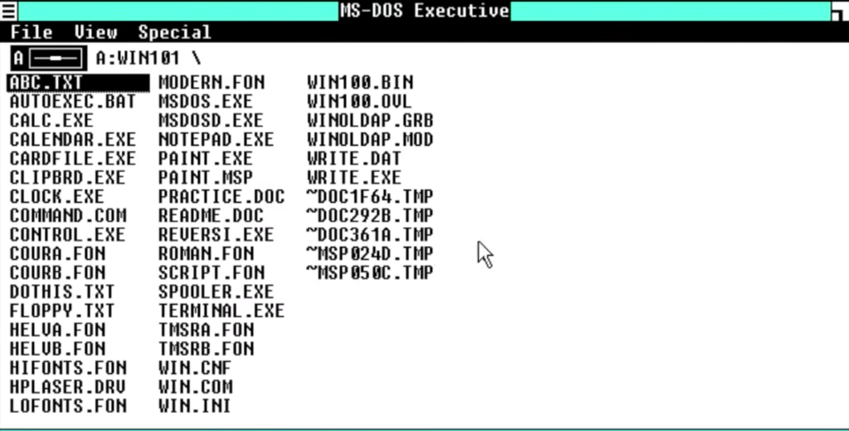
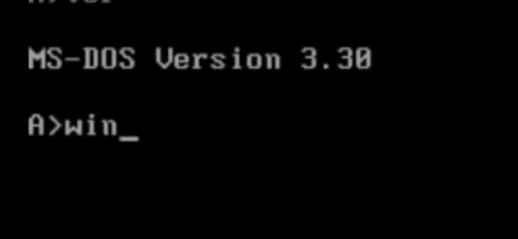

Slide 10
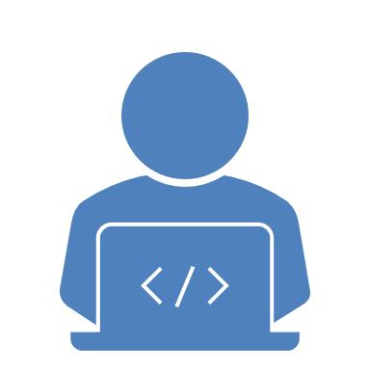
What is MS DOS
stands for Microsoft Disk Operating System. It was an earlier, text-based operating system developed by Microsoft. It was the dominant operating system for personal computers (PCs) from the early 1980s until Windows took over in the mid-1990s.

Slide 11
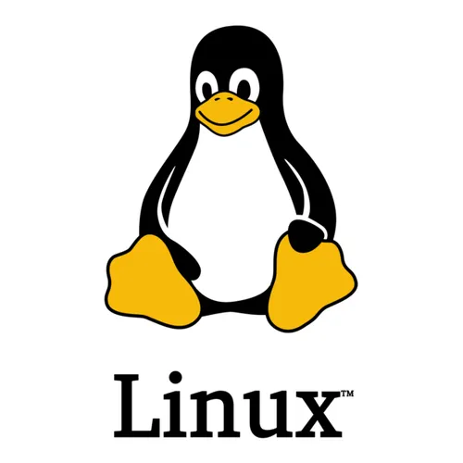
Linux
open-source operating systems that are based on the Linux kernel. It's similar in function to Windows or macOS, but with a key difference: it's free and open-source, meaning its code is publicly available for anyone to use, modify, and distribute.

Slide 12
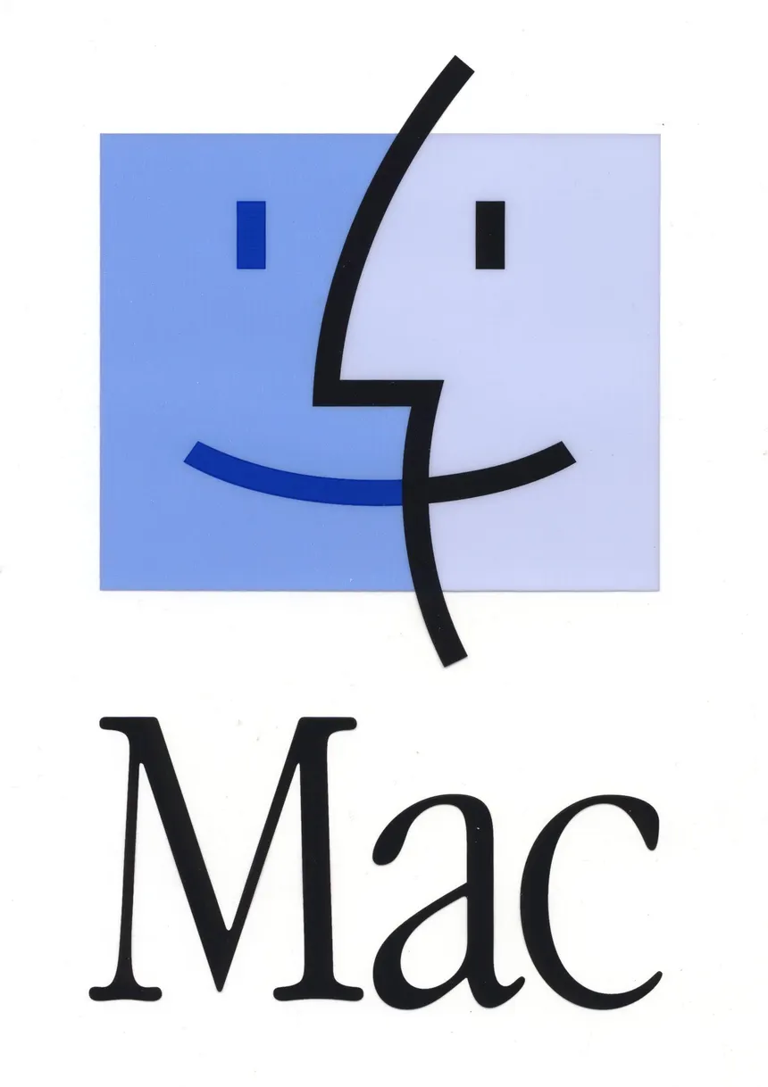
MacOS
is the operating system developed by Apple Inc. for its Macintosh line of computers. It's the software that allows you to interact with your Mac, run apps, manage files, and connect to the internet.

Slide 13
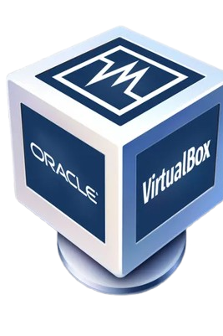
Installing OS using VirtualBox
What is VirtualBox?
A virtualization tool that allows running multiple OS on one machine.
Requirements:
• ISO file of OS
• Sufficient RAM and disk space

Slide 14
Steps in Installing an OS via VirtualBox
• Download and install VirtualBox
• Create a new virtual machine
• Allocate RAM and storage
• Attach the ISO file
• Start the VM and follow OS installation steps

Slide 15
Benefits of Using Virtual Machines
• Test multiple OS without needing extra hardware
• Safer environment for software testing
• Portable and easy to reset

Slide 16
Let’s get hands on open your pc.

